Slide 1
Employee Data Analysis using Excel
STUDENT NAME: PRIYADHARSHINI M
REGISTER NO:2213331042132
DEPARTMENT: COMMERCE
COLLEGE: BHARATHI WOMEN'S COLLEGE

Slide 2
PROJECT TITLE
Employee Salary Analysis using Excel

Slide 3


AGENDA
Problem Statement
Project Overview
End Users
Our Solution and Proposition
Dataset Description
Modelling Approach
Results and Discussion
Conclusion
3/21/2024 Annual Review

Slide 4

PROBLEM STATEMENT
Analyze the factors influencing employee salaries to identify potential discrepancies, ensure fairness, and align compensation with industry standards. The goal is to optimize salary structures and address any disparities in pay.

Slide 5

PROJECT OVERVIEW
This project involves examining employee salary data to identify key determinants of compensation, uncover potential disparities, and recommend adjustments to ensure equitable and competitive pay across the organization.

Slide 6

WHO ARE THE END USERS?
The end users of this analysis include HR managers, company executives, and department heads who are responsible for making decisions on employee compensation, as well as the employees themselves who are affected by salary policies.

Slide 7

OUR SOLUTION AND ITS VALUE PROPOSITION
A salary analysis tool that identifies pay disparities and optimizes compensation structures. It ensures fair, competitive salaries, enhancing employee satisfaction and retention.

Slide 8
Dataset Description
The dataset includes employee information such as job titles, departments, years of experience, education level, gender, location, and current salary. It may also include performance ratings, salary history, and industry benchmarks for comparison.

Slide 9

THE "WOW" IN OUR SOLUTION
Our solution stands out by offering real-time, data-driven insights that not only detect salary disparities but also provide personalized recommendations for equitable adjustments, ensuring transparency and fostering a culture of fairness within the organization.
3/21/2024 Annual Review
9

Slide 10
MODELLING
The modeling phase involves developing and applying statistical and machine learning models to predict salaries based on various factors such as experience, education, and job role. Techniques like regression analysis, decision trees, or clustering may be used to uncover patterns, identify key salary determinants, and detect anomalies or disparities. These models help in making data-driven recommendations for optimizing salary structures and ensuring fairness.
10

Slide 11
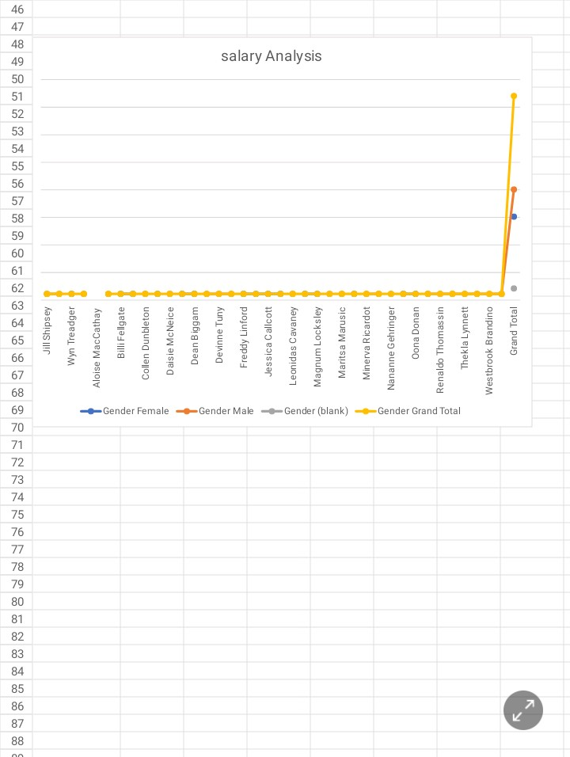
RESULTS
11

Slide 12
conclusion
In conclusion, our salary analysis provides actionable insights that help organizations ensure fair and competitive compensation practices. By leveraging data-driven models, we can identify and address salary disparities, ultimately fostering a more equitable workplace and enhancing employee satisfaction and retention.

